Slide 1
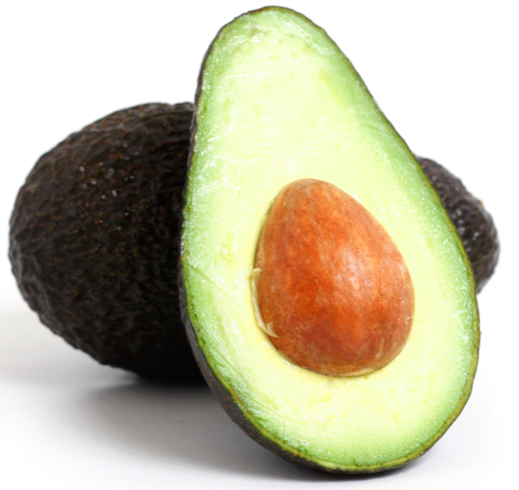
Machine Learning 1 Project
Avocado Pricing Dataset
Presented by Clifer Fernandez – April 2020 cohort

Slide 2
Agenda
Introduction
Executive Summary
Data Profiling and Analysis
Machine Learning Model
Conclusions
Recommendations

Slide 3
Introduction
Dataset - Average Pricing for single Avocado
10 numerical – price, sales volume, etc.
3 categorical – type, region, year
Our Task
Select and Train a ML model to help predict the average price of a single avocado

Slide 4

Executive Summary
Original data set – 18249 records, no missing / null
Analysis
Covers years 2015 – Q1 2018
Extremely high correlation between majority of variables
Small / medium size of conventionally grown, packed in small bags are preferred
Increasing sales volume over the years
Machine Learning Model
Regression models preferred
Random Forest Regressor model gives best result
Recommendations
Other feature engineering methods
More powerful algorithms
Support Vector Machines (SVM)
Artificial Neural Networks (ANN)

Slide 5
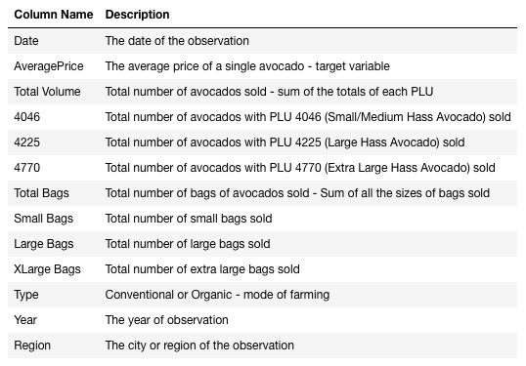
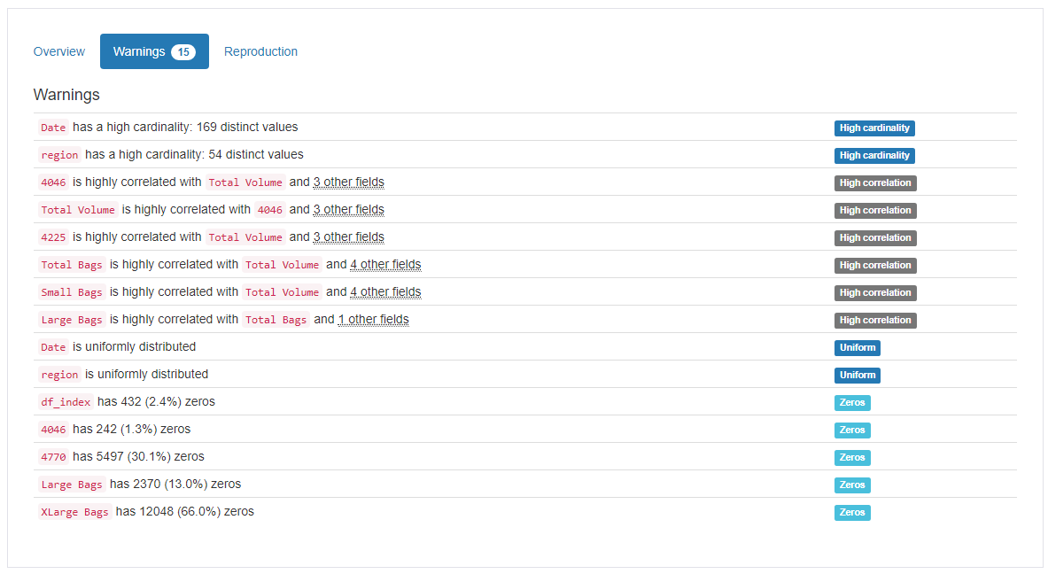
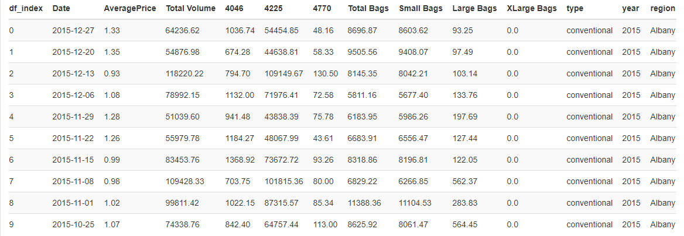
Data Profiling
Data set
Import data
View records
Basic stats
Profiling

Slide 6
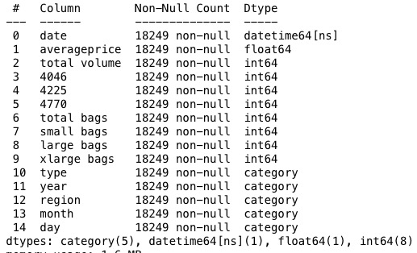
Data Profiling - Pre-processing
Pre-processing
Check data distribution
Review and convert to relevant data type
Review perceived outliers

Slide 7
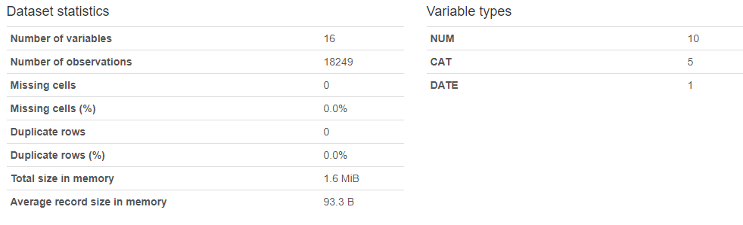
Data Profiling – Post Profiling
Post Profiling
Rerun stats
profiling

Slide 8
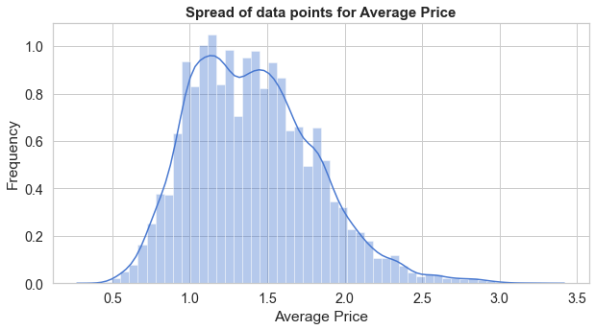
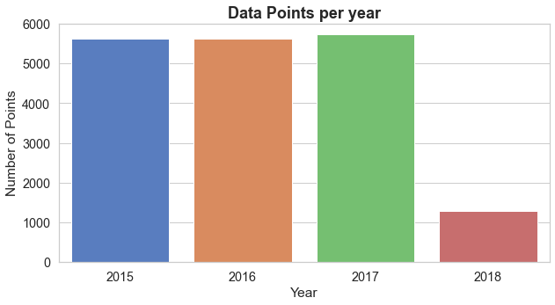
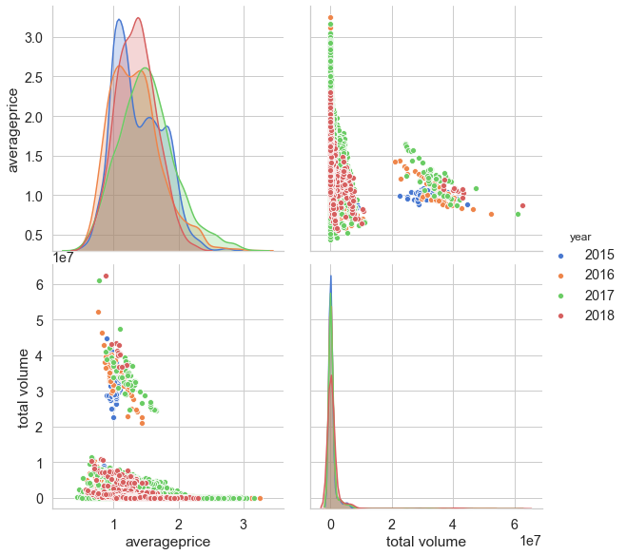
Data Analysis
Data spread
3+ years worth of data
Average Price
Normal distribution
Target variable for prediction
Total Volume
Right skew in data
Includes data points for ‘Total US’

Slide 9
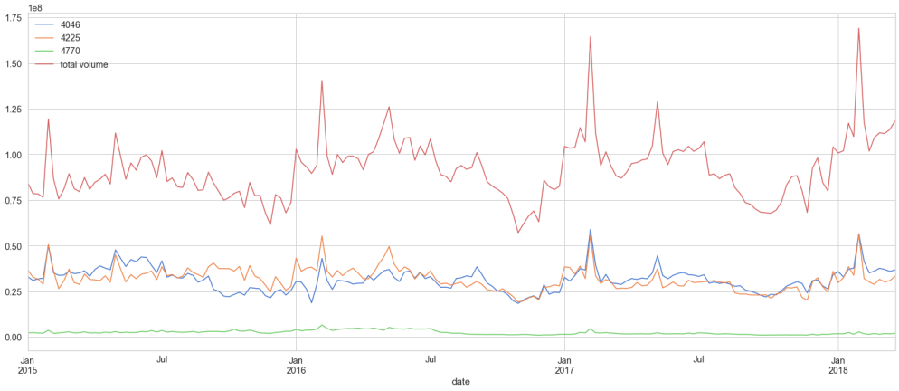
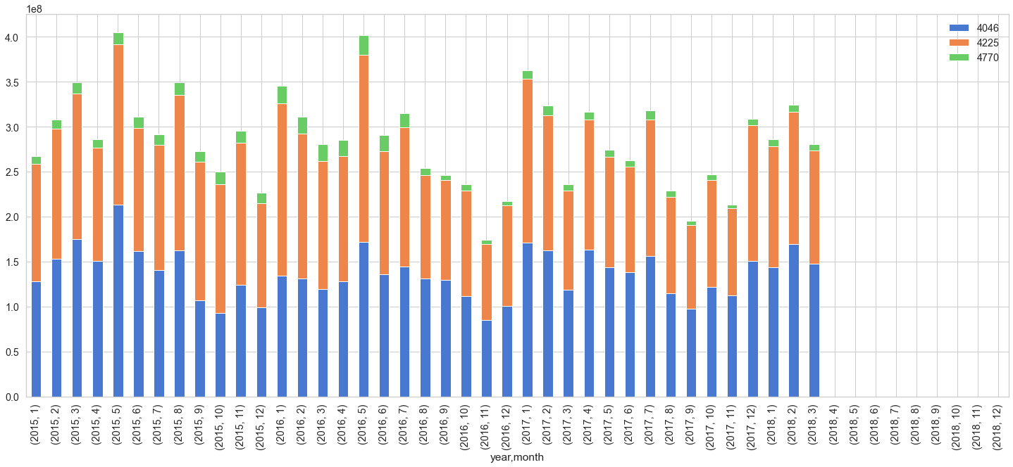
Data Analysis
Volume Sale by Avocado Grade
Small and medium size preferred over large
X large is a niche product
Spike in sale around Feb every year

Slide 10
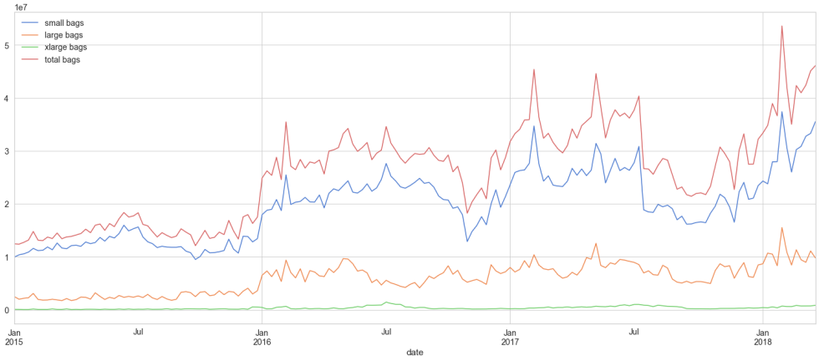
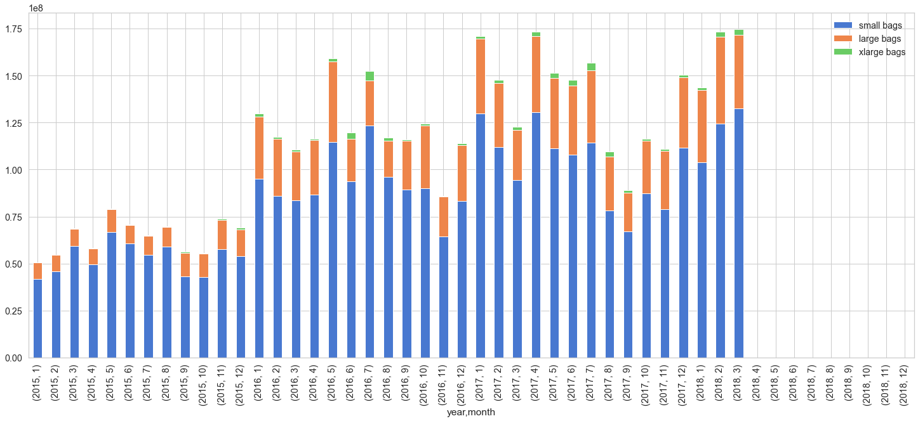
Data Analysis
Bag size preference
Small bag size preferred
XL size sold is very small numbers

Slide 11
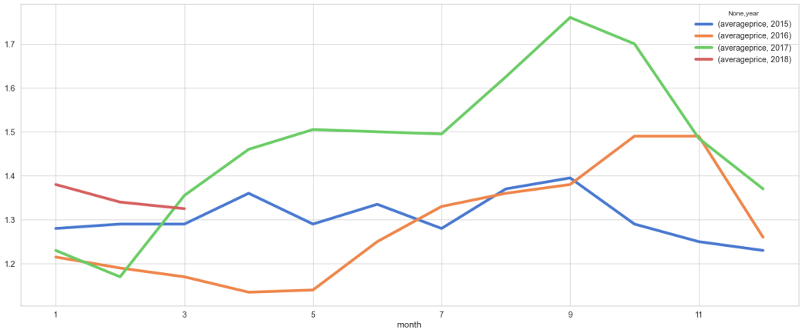
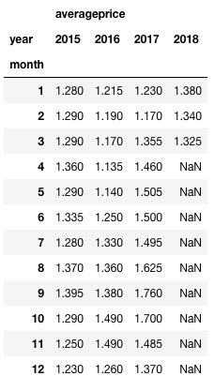
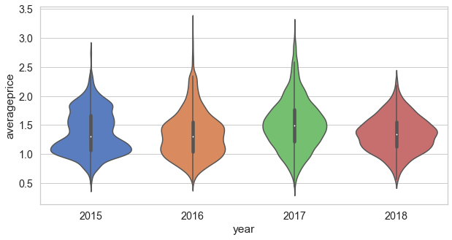
Data Analysis
Annual variations in Average Price
range is between 1.2 – 1.5
peaks during Sep – Oct every year
2017 prices were generally higher
attributed to a poor harvest leading to shortage in supply

Slide 12
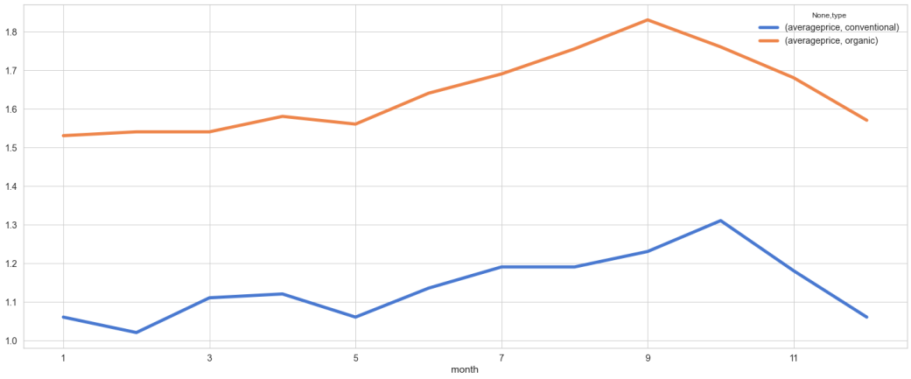
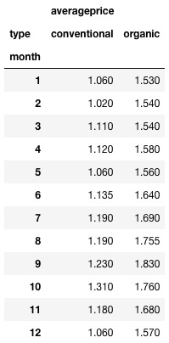
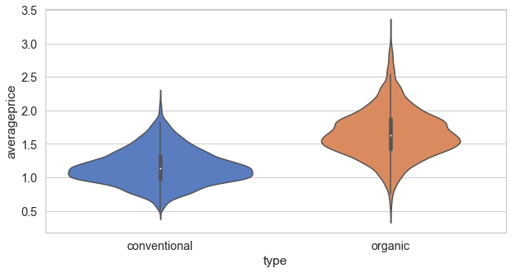
Data Analysis
Annual variations in Average Price by Type
Organic avocados are higher priced
Can be attributed to higher cost of production

Slide 13
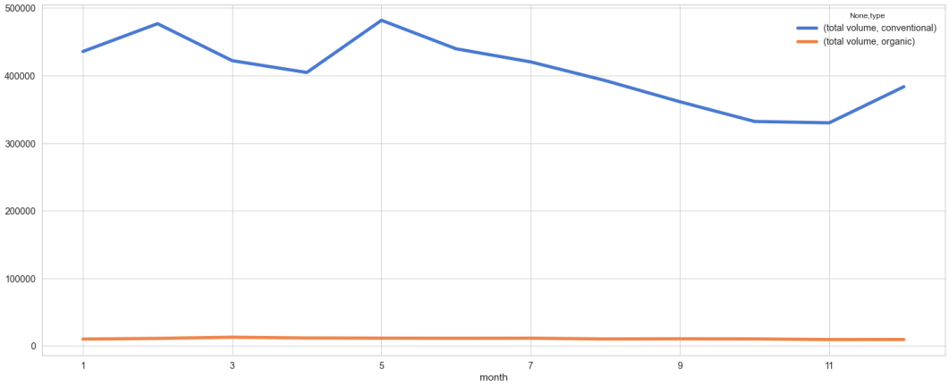
Data Analysis
Annual variations in Total Volume by Type
Conventionally farmed avocados are by far the most in demand
Organic avocados are a very ‘niche’ sale item

Slide 14
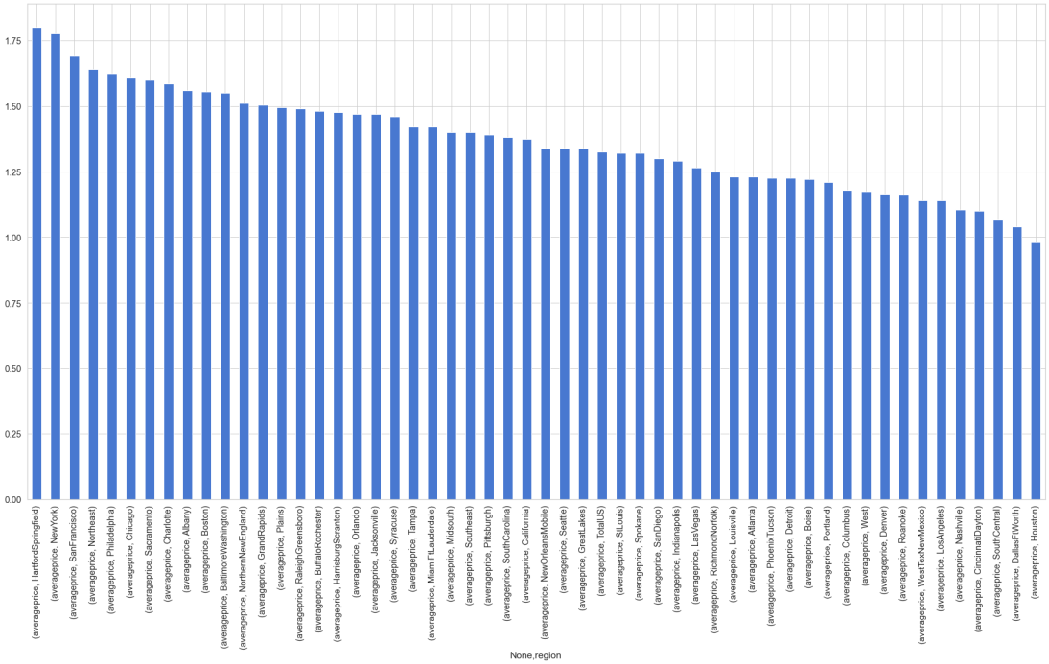
Data Analysis
Top 5 cities with highest average price
Hartford Springfield
New York
San Francisco
Philadelphia
Chicago
Note: The ‘regional’ areas were not selected for the listing although they are plotted in the graph

Slide 15
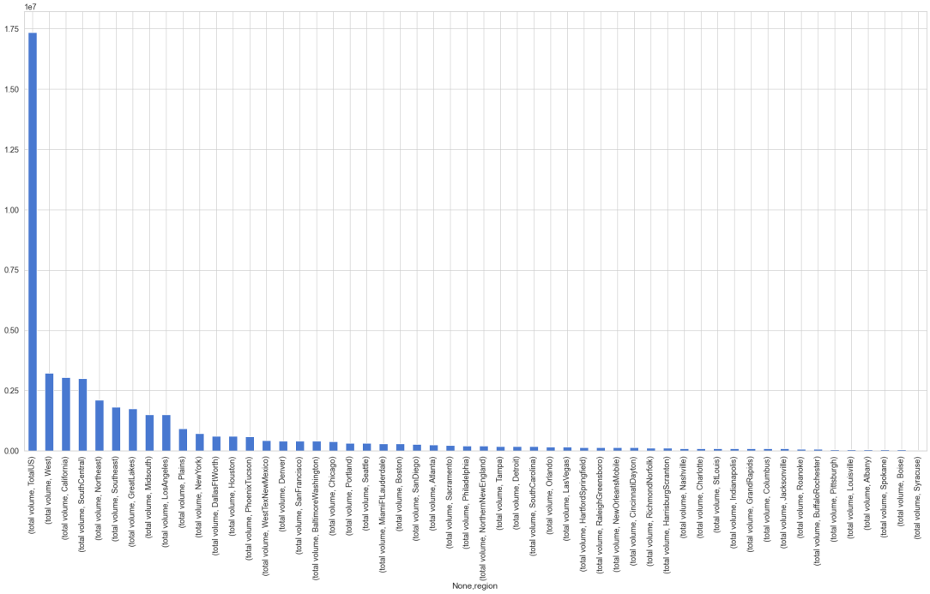
Data Analysis
Top 5 cities with highest total volumes
Los Angeles
New York
Dallas
Houston
Phoenix
Note: The ‘regional’ areas were not selected for the listing although they are plotted in the graph. The ‘high’ tower is the Total US volume data point

Slide 16
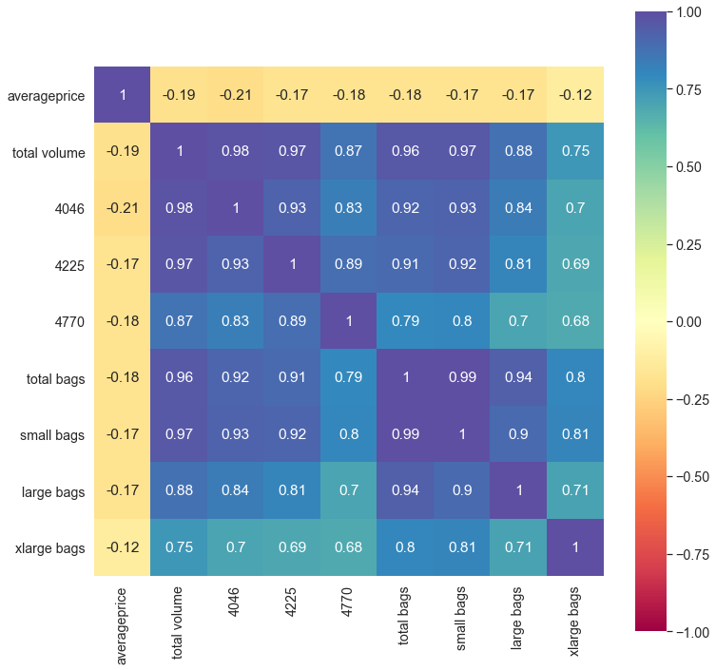
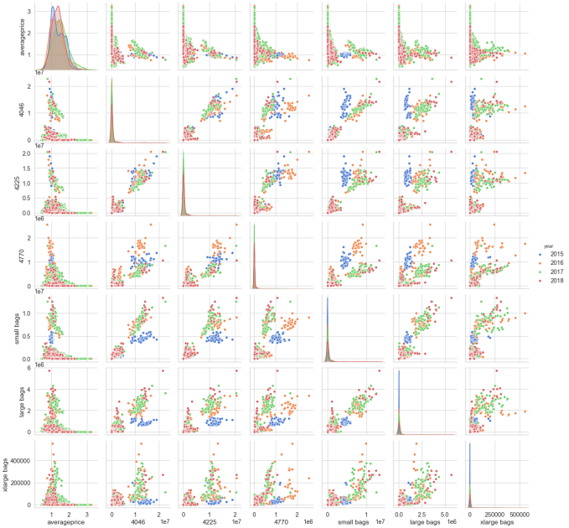
Data Analysis
Parameter correlation
Very high correlation among variables
Redundant information will be excluded for model building

Slide 17
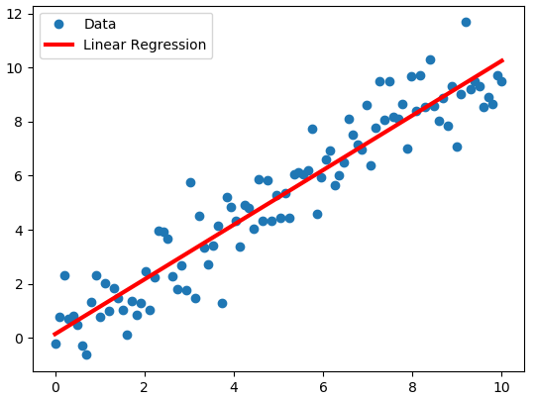
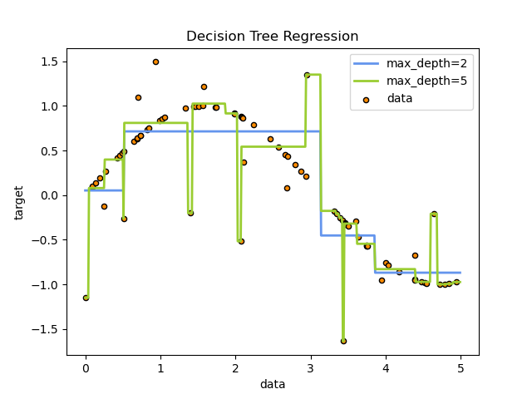
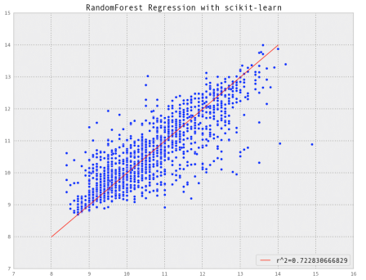
Machine Learning Model
Regression Models Selected
Linear Regression
Decision Tree Regressor
Random Forest Regressor

Slide 18

Machine Learning Model
Model building
Train – Test Split dataset
Scaling of the data
Running the regression models
Model evaluation

Slide 19
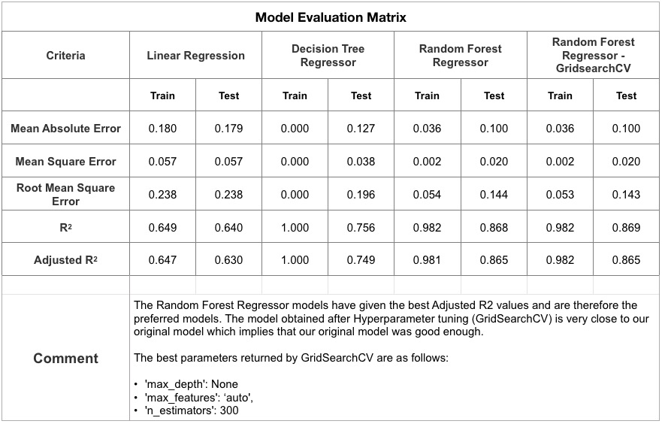
Machine Learning Model

Slide 20
Conclusions
Dataset for 3 full years and Q1 of the fourth
Average Price is normally distributed
Small / medium sized avocados in small sized bags are preferred
Annual variation in price, peaking in Sept – Oct
Conventionally farmed option preferred
Perhaps due to lower costs

Slide 21
Conclusions
Pricing can be predicted using Machine Learning Models
Regression Models selected
Random Forest Regressor provided the best model

Slide 22

Recommendations
Model Improvement
More powerful Algorithms
Support Vector Machines (SVM)
Artificial Neural Networks (ANN)

Slide 23

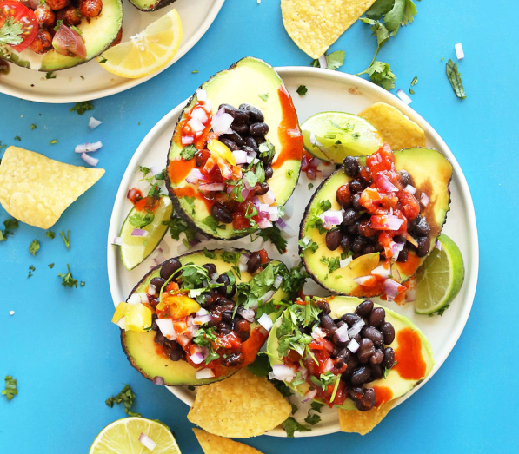
Thank You!
Bon Appetite!

